Slide 1
Lecture 5
Network Models of Cities
5.3 Scale Invariance: Examples
IUS 3.1, 3.2
© Luís M. A. Bettencourt 2023
Notes:
This module introduces fundamental ideas about network effects, scaling and their expression in terms of exponentials and logarithms.

Slide 2
Network Effects
The value of a network is proportional to the number of its connections
Connections grow faster than proportionally to the number of nodes
$$Y∼N^{2}$$
Metcalfe’s Law
Can this happen for cities?

Slide 3
Scaling Effects
“The laws of complex systems”
(log world)
How a quantity in a system depends on another (scale)
$$Y=f(N)$$
Scale Invariance
$$Y=f(λN)=λ^{β}f(N)$$
?
“homogeneous of degree β”
“power-law"
solution:
$$f(N)=aN^{β}$$
Notes:
This is why power laws are “scale-invariant” : they apply at all sizes.

Slide 4
Properties of the Logarithm
The living world is a “log world”: of relative growth .
$$\log_{10}(e^{x})=\frac{\log_{e}(e^{x})}{\log_{e}(10)}$$
$$e^{log(x)}=x,$$
change of base: just divides by a constant
1. Inverse of exponential:
$$log(e^{x})=x$$
we will commit the base for simplicity
plots often in base 10; equations in base e
2. Turns multiplication into addition:
$$log(x.y)=log(x)+log(y)$$
3. Exponents come out and multiply:
$$log(A^{x})=x.log(A),$$
$$γ(t)=\frac{dlog(A)}{dt}=\frac{\frac{dA}{dt}}{A}$$
$$logA(t)=∫dt\frac{dlogA}{dt}=\overline{γ}t$$
4. Derivatives are “percent” changes:
growth rate

Slide 5
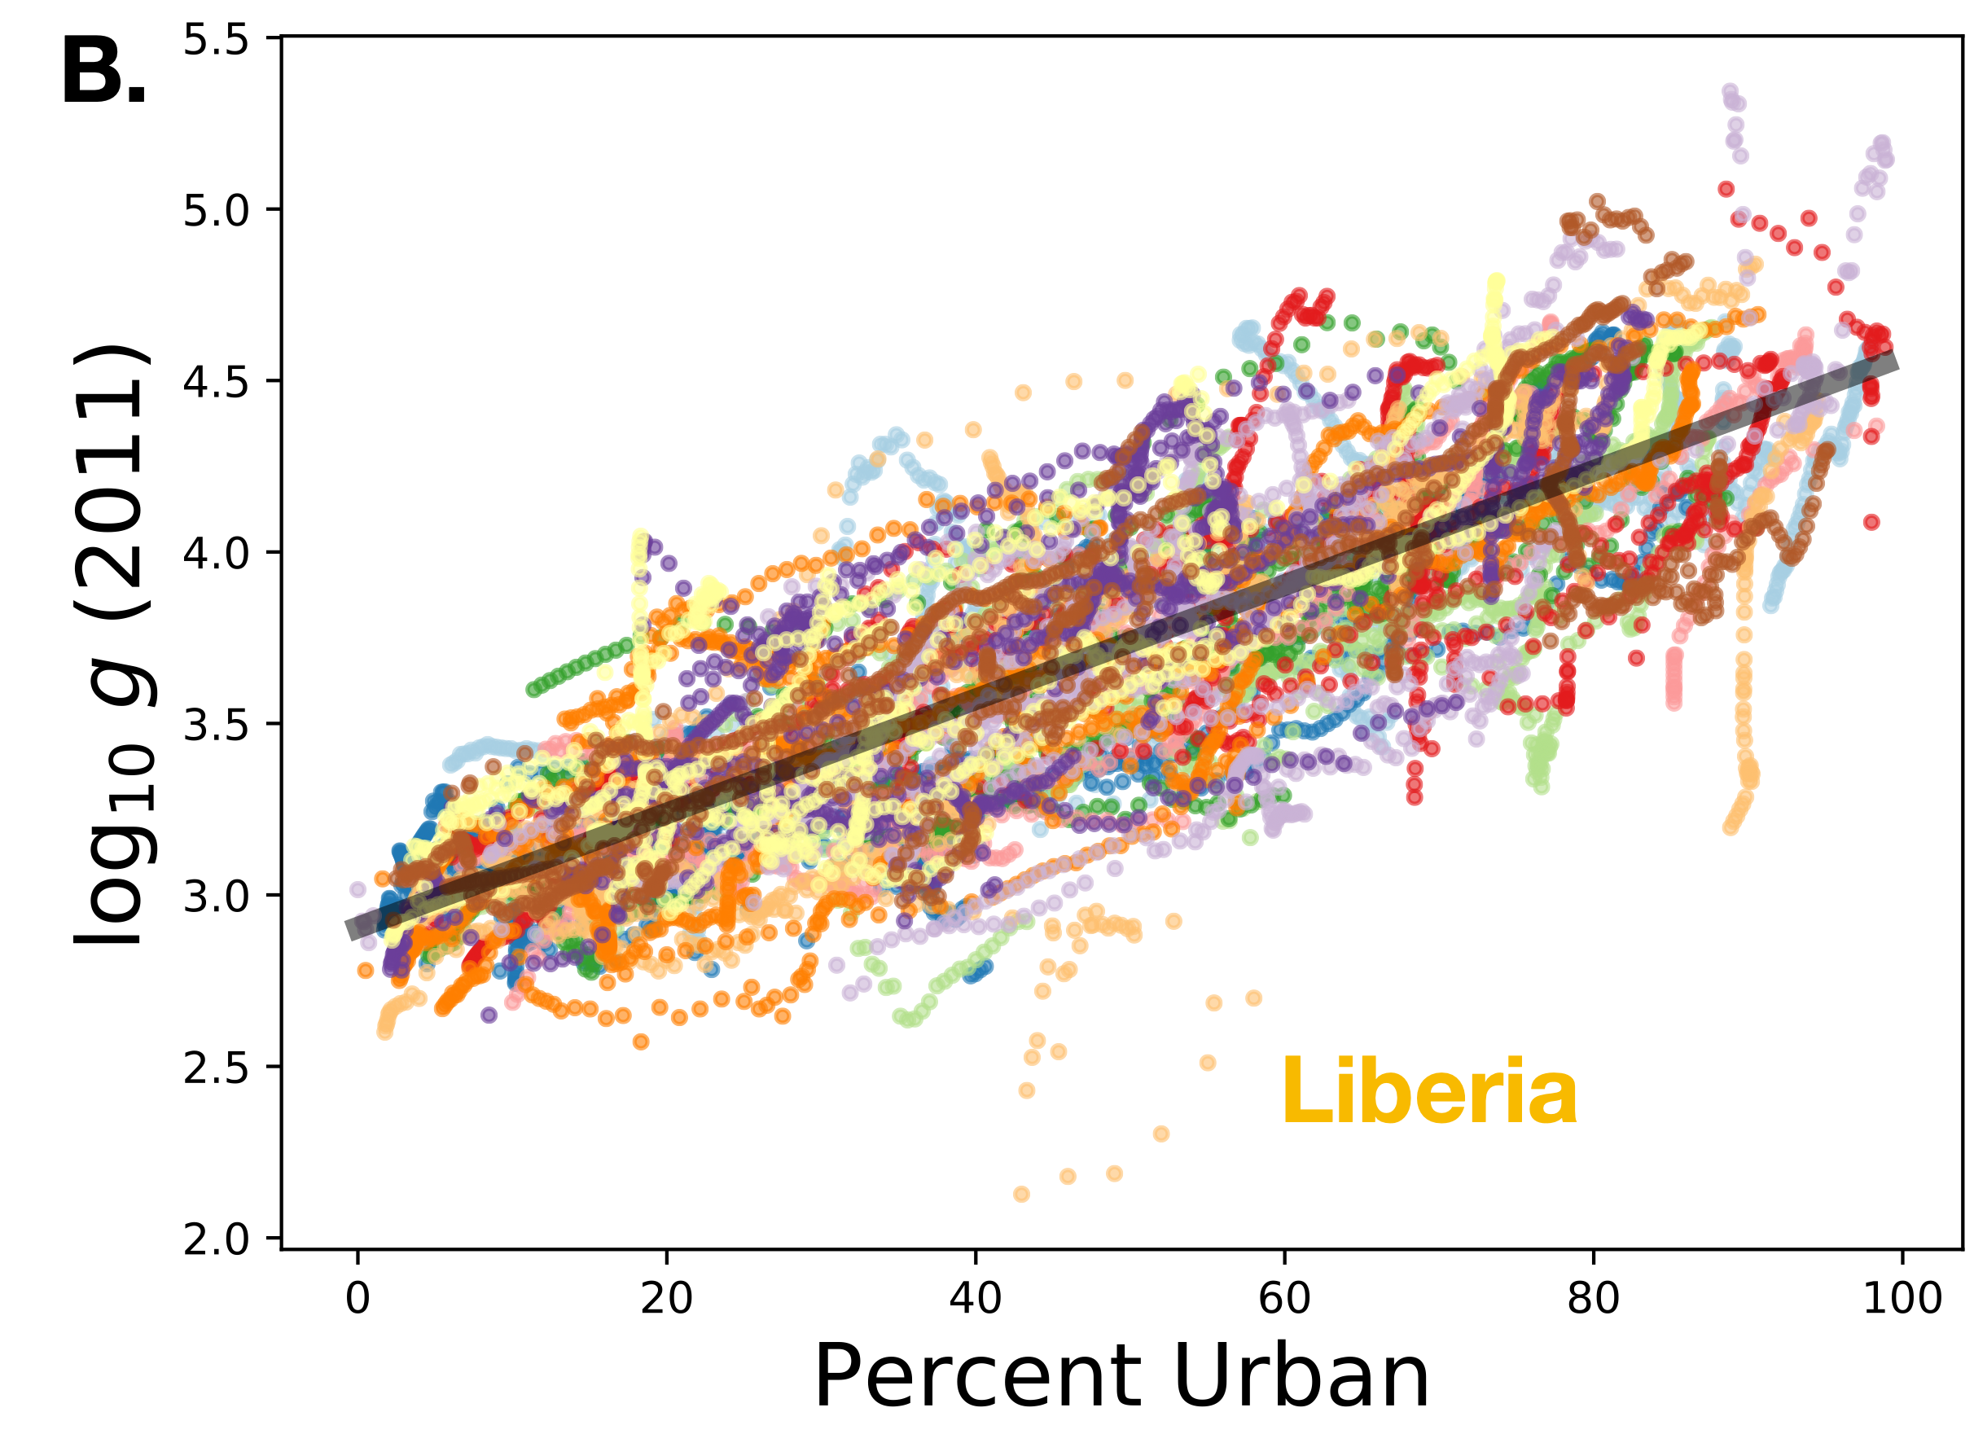
3. Economic Growth and Urbanization
Remember? what does it mean?
National GDP per capita increases 4-5% with each percent increase in the percent of people living in cities
Notes:
When we plot the logarithm of a quantity we are plotting a growth rate integrated over some time.

Slide 6
Now let’s use those logarithms
Scaling Effects
$$f(N)=aN^{β}$$
more than doubles
$$β>1$$
superlinear
When you double N ( ), Y also doubles
$$β=1$$
linear
$$λ=2$$
less than doubles
sublinear
$$β<1$$
Properties of logs
Can write this as:
$$β=\frac{dlnf(N)}{dlnN}=\frac{\frac{df}{f}}{\frac{dN}{N}}$$
exponent
$$lnf(N)=lna+βlnN$$
“elasticity”
logarithms transform products into sums
recall that:
$$lne^{β}=β,$$
$$N^{β}=e^{βlnN}$$
“an x percent change in N, leads to a β x percent change in f”
Metcalfe’s law says that the value of a network is superlinear on the number of its nodes

Slide 7
Examples of scaling relations

Slide 8
Example: the air in this room
IUS 3.1.2
Scaling Effects and Systems
Nothing much happens with size:
a bottle of gas has the same properties
as the entire Earth’s atmosphere
energy/ball
“Ideal gas” : no interactions
$$E=eN$$
total energy
number of balls
$$A=nN$$
linear
area
density
Notes:
Scaling is a power law of properties of a system, relative to a variable capturing its size. It is a very general method, from physics…

Slide 9

Scaling Effects and Systems
(examples)
diffusion
the milk in your coffee
$$Δx$$
Time and space become intertwined …
$$Δx=\sqrt{2DΔt}$$
sublinear:
$$Δx∼t^{1/2}$$
Spatial extent of ink
Time elapsed
Notes:
To diffusion…. (How space relates to time)

Slide 10
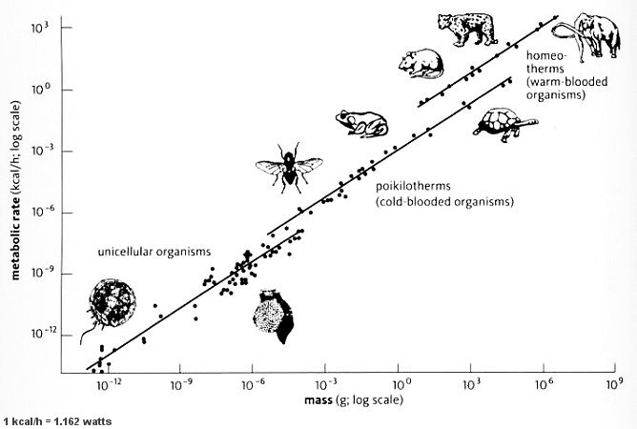
Kleiber’s Law
life slows down with size
biological metabolism=Energy/time ~ Mass ^{3/4}
West, Brown, Enquist 1997, …
Notes:
To biology (metabolism)

Slide 11
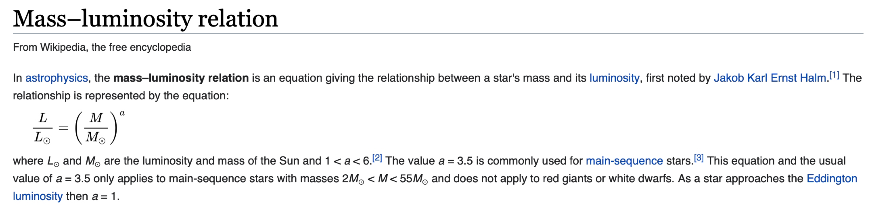
Star’s Luminosity versus its Mass
credit : wikipedia
Stars burn brighter, live faster the more massive they are
Notes:
To stars…

Slide 12
Different complex systems have different scaling relations
these express properties of structures that result from
attractive and repulsive forces
What kind of scaling relations will cities have?

